Slide 1

AUTOMATED RAILWAY
CROSSING

Slide 2

TEAM CIPHER
MEMBERS:
GAGAN KUMAR S (C)
SPOORTHY M
TEJAAS M REDDY
THANUSH M
VIGANESHA H R
VINAY N B
YASER AHMED N

Slide 3
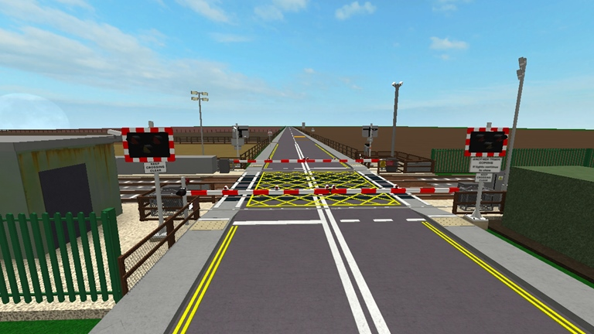
INTRODUCTION:
It is very important to monitor the railway crossings at all times as it’s the region that’s prone to accidents. Our aim is to completely make the railway crossing completely unmanned by providing an automatic railway gate solution. By this the rate of accidents can be reduced and peoples lives can be saved.

Slide 4
UNIQUE SELLING POINT:
The unique selling point of our project is we have included the LCD display, which displays the current status of the train (i.e. distance of the train from the crossing). The LCD display can also be used to display advertisements when not in use, thus adding to the business value of the project.
Another USP is that we have implemented the notifications. The notification will be sent to the station master if the train is late or earlier than expected.

Slide 5
COMPONENTS USED:
NODEMCU
IR SENSORS
LCD DISPLAY
SERVO MOTORS
LED
BUZZERS

Slide 6

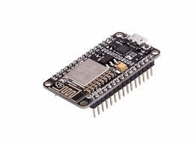
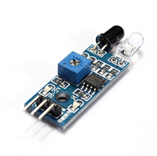
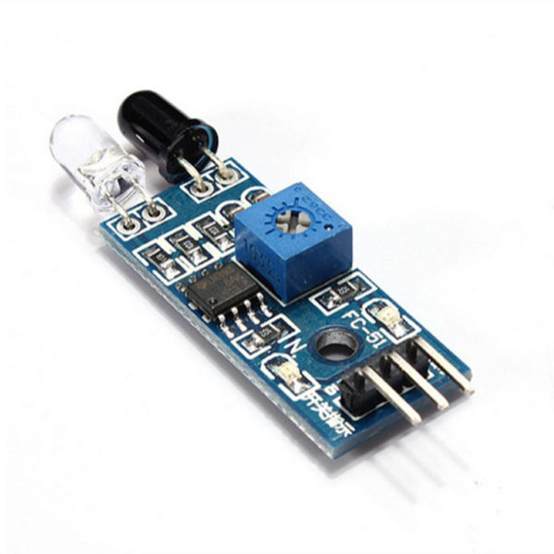


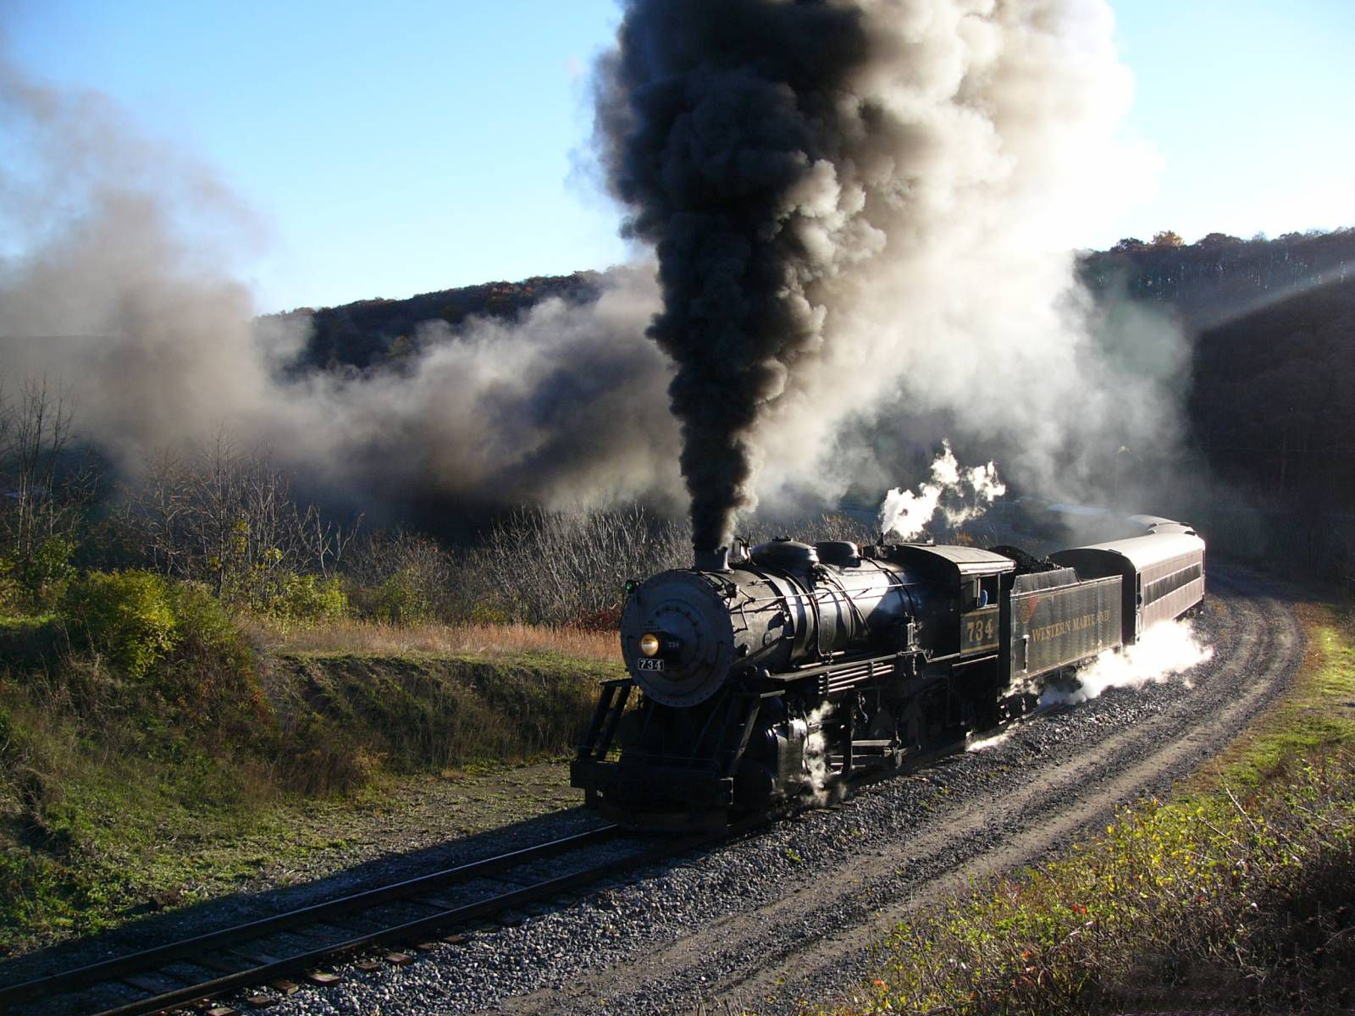
FLOWCHART:
NODEMCU
CLOUD
IR SENSORS

Slide 7
DEMONSTRATION
OF THE PROJECT

Slide 8
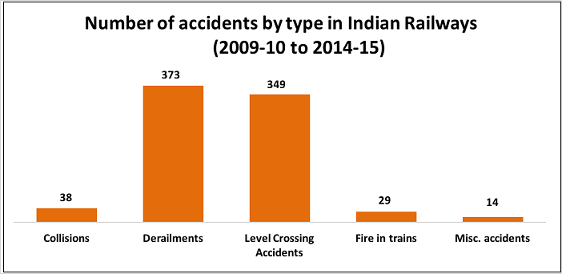

Slide 9

CONCLUSION:
We would like to conclude our presentation by thanking tequed labs for this opportunity. We would love to attend all the events which they host in the future.
THANK YOU

